Slide 1


TOPIC 7:
Demonstration of types of
viruses and its mechanism
Team 3:
Pham Thanh Truong 20194460 Phan Manh Tuan 20194461
Workloads

Slide 2
Problem statement
Design application with these properties:
On MainScreen:
Users can choose to investigate a virus with lipid envelope or virus without envelope
Help menu contains “usage”, “aim of application” and “problem”.
On StructureScreen (after choosing a virus ): User will see general structure
Slide mouse to a part to explore and click to see detail
A button “infect” to see infecting process
On InfectingScreen (after choosing “infect” button): Show infecting process

Slide 3
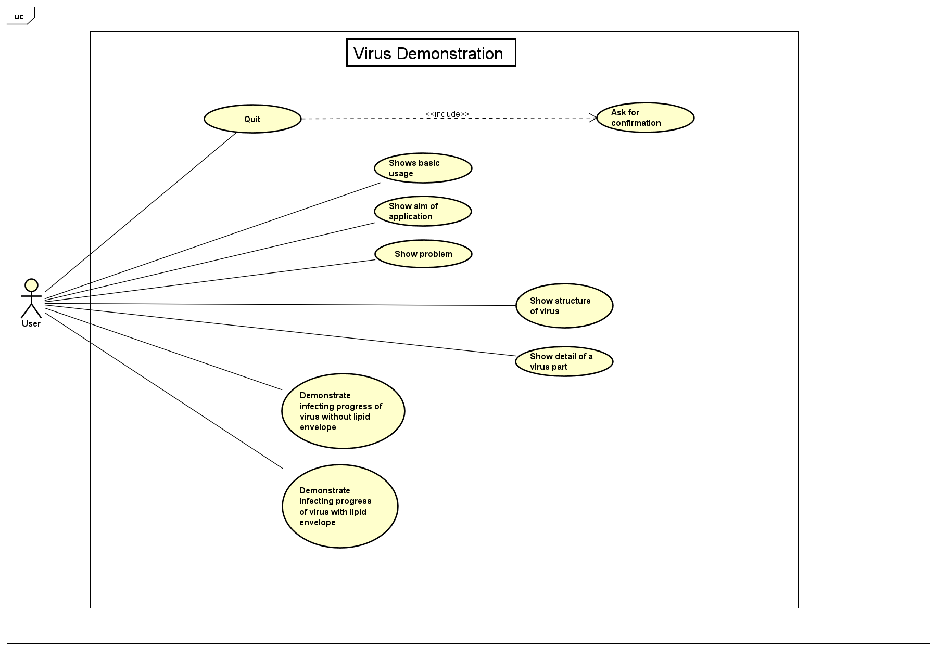
UseCase Diagram

Slide 4
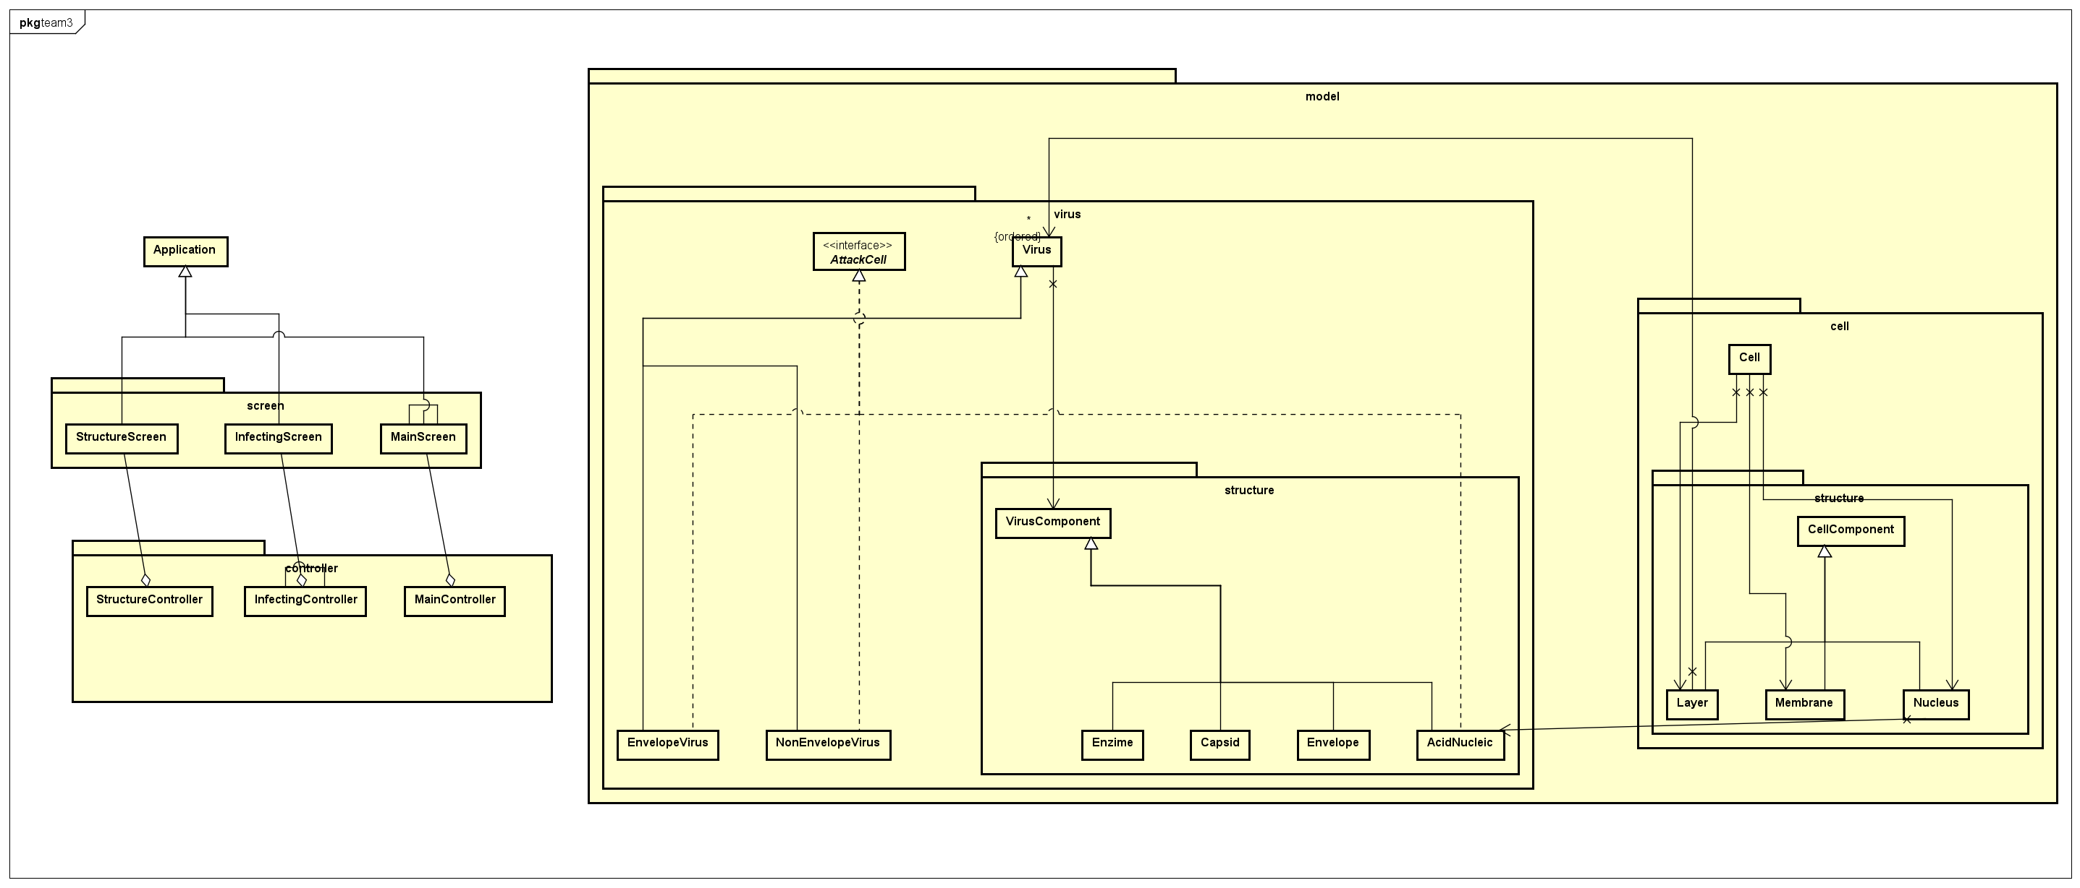
General Class Diagram

Slide 5
Detail Class Diagram

Slide 6
Detail Class Diagram

Slide 7
OOP Techniques
Polymorphism :
Attack : Many way to attack (Virus with envelope, Virus without envelope, Nucle)
Encapsulation:
Connect through public method (GetImageOf, getComponentOf ... )
Abstraction:
Abstract class Virus
Thinking in general terms rather than specific term ( Virus components)

Slide 8
OOP Techniques
Inheritance:
NonenvelopeVirus, EnvelopeVirus inheritate from Virus
Parts of Cell: Layer, Membrance, Nucleus inheritate from CellComponent
Parts of Virus: AcidNucleic, Enzime, Capsid, Envelope, ... Inheritate from VirusComponent
Aggregation:
Virus has many Virus Components
Cell has Cell Components

Slide 9
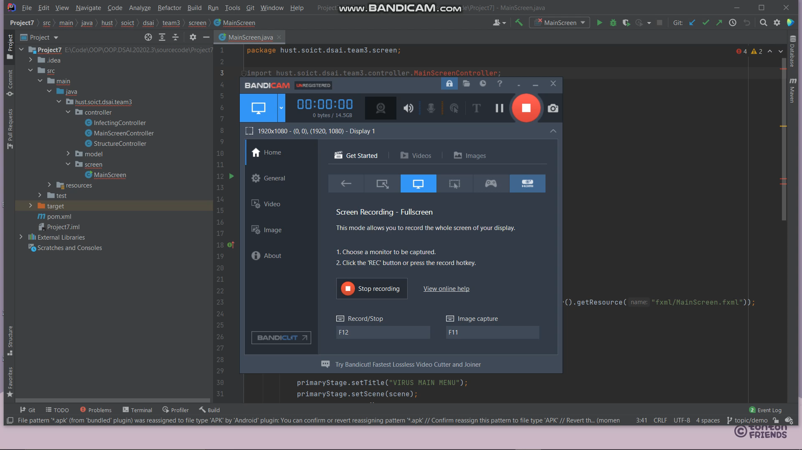
Demo Scenario
Click here to see Demo

